Slide 1

A generative approach
to learn two corpora’s overlap
Juncheng Ding May 8, 2019

Slide 2
Contents:
What?
Why?
How (previously)?
How (we do)?
Experiment;
Conclusion;

Slide 3
What is the overlap between two corpora?
Documents on Natural Language Processing
Overlap:
Machine Learning;
Artificial Intelligence;
Documents on
Computer Vision

Slide 4

Why we need the overlap?
A better way to access the large amount of documents;
A new summarization task;
I am an NLP researcher, but I want to learn CV. What background do I have?
Original image from: https://bornrealist.com/pictures-of-people-thinking-6807/

Slide 5
How previously do? (Related work)
Documents Summarization:
One Corpus
One document or one group of documents;
One Corpus
…
Main Idea
One Corpus
One document
Topic 1
Similarity, difference or both;
Comparison between Topics
Topic 2
One document
…
supervised
Topic n

Slide 6
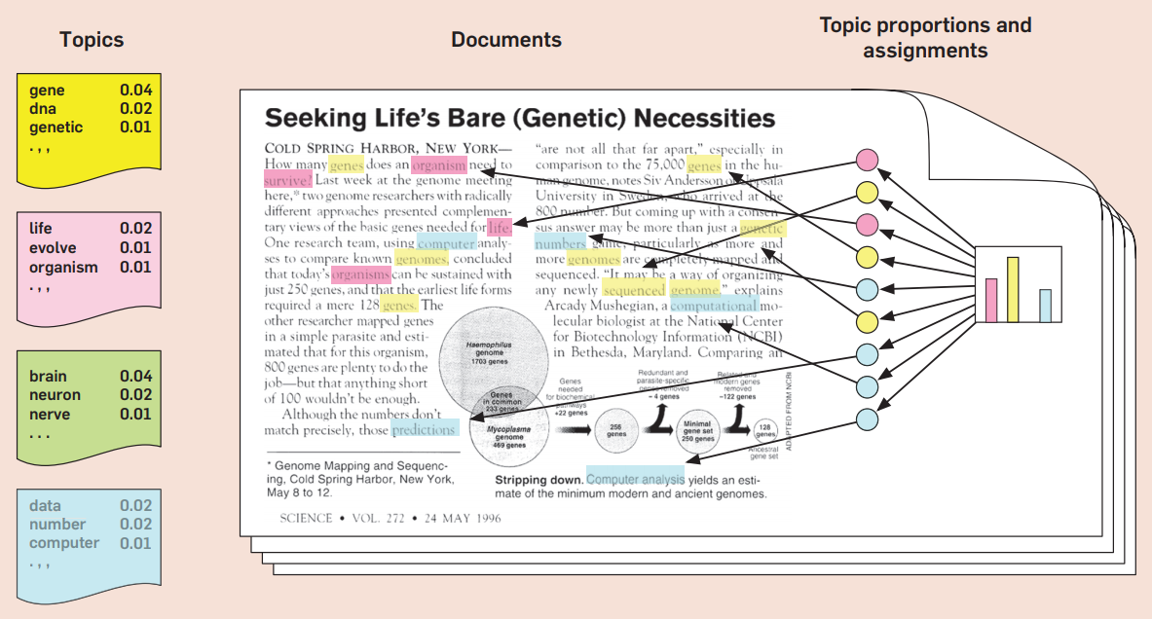
How previously do? (Related work)
Topic Models:

Slide 7
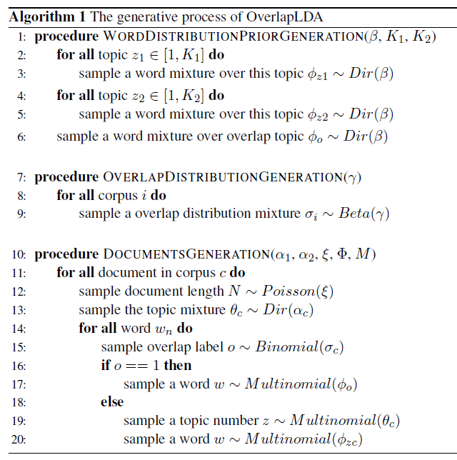
How we do? (Our Model)
Corpus 1
Corpus 2
Topic 1
One overlap topic
Topic 1
Topic 2
Topic 2
…
…
Topic K1
Topic K2

Slide 8

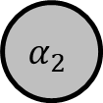
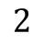


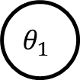
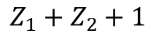
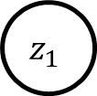
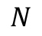
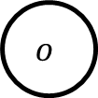
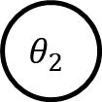

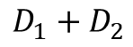
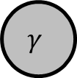
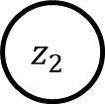
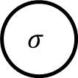
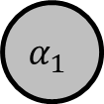
How we do? (Our Model)
$$α_{1}$$
$$θ_{1}$$
$$z_{1}$$
$$N$$
$$Z_{1}+Z_{2}+1$$
$$c$$
$$w$$
$$φ$$
$$β$$
$$α_{2}$$
$$θ_{2}$$
$$z_{2}$$
$$o$$
$$σ$$
$$2$$
$$γ$$
$$D_{1}+D_{2}$$

Slide 9

Experiments
Preparation: (two pairs of corpora)
Selection: cs publications and news articles
cs: 17 areas, 136 pairs
news(rec): 4 areas, 6 pairs
basic documents preprocessing
stop words removal
E.g. the, is, at …
lemmatization
E.g. played->play, computers -> computer

Slide 10
Experiments
Annotation : (two pairs of corpora)
0: not relevant or too genera
1: partially relevant
2: relevant
Computer graphics vs Algorithm design

Slide 11
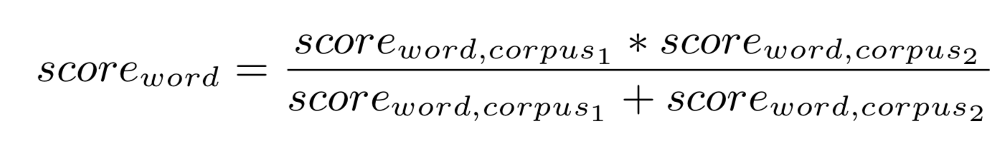
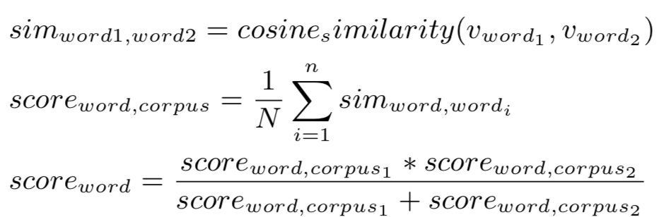
Experiments
Comparative Approaches
word frequency
word2vec

Slide 12
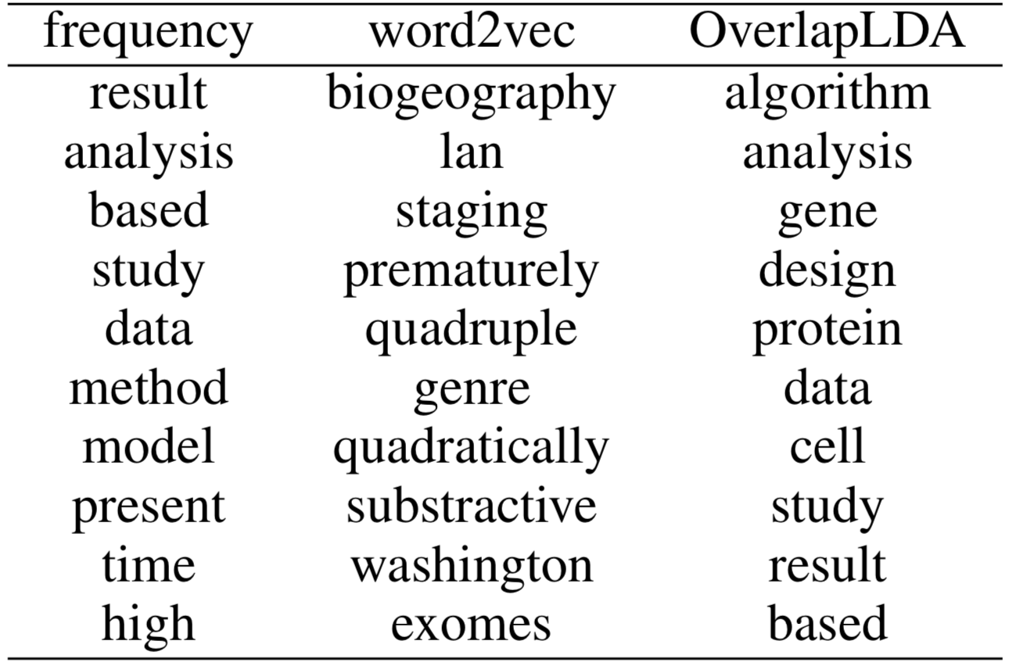
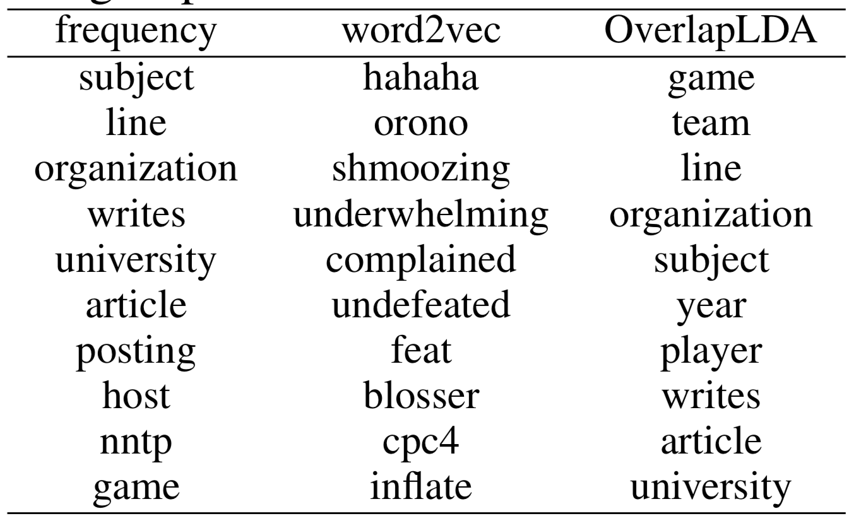
Experiments
Case Studies
top 10 words
Algorithm Design vs Bioinformatics
Baseball vs hockey

Slide 13
Experiments
Case Studies Results
frequency : more common words
Word2vec: partial relevant words
Our OverlapLDA: the most overlap words

Slide 14
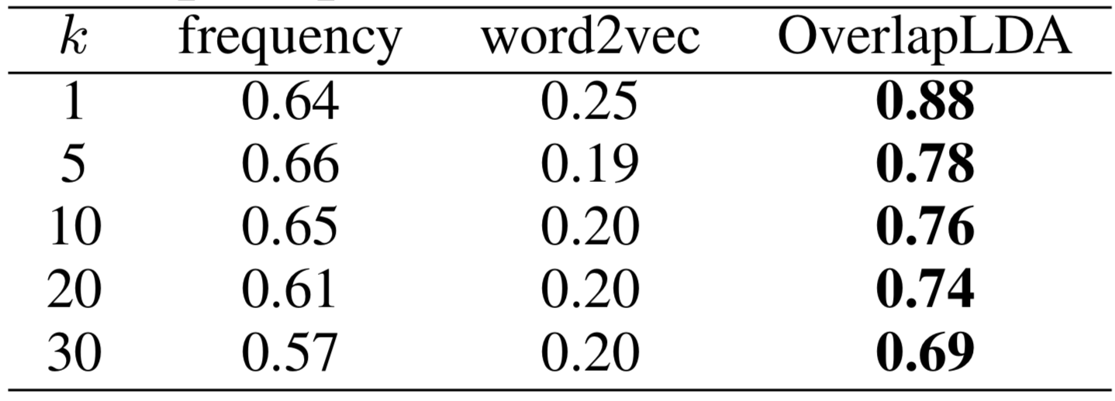
Experiments
Quantitative Experiments
The precision@k scores for science corpora pairs

Slide 15
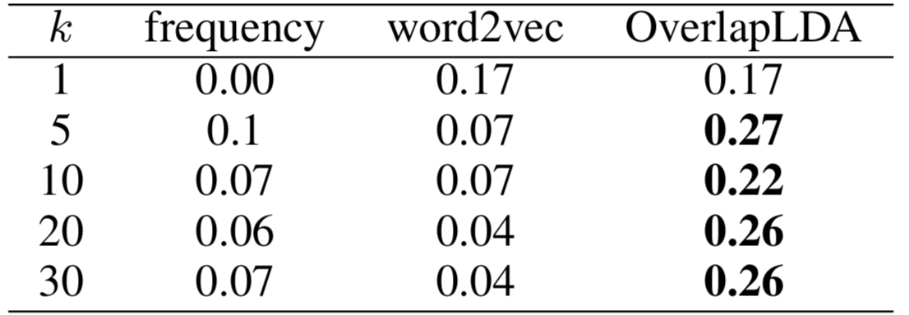
Experiments
Quantitative Experiments
The precision@k scores for news corpora pairs

Slide 16
Experiments
Quantitative Experiments Result
OverlapLDA always performances better than frequency and word2vec .
Performance on 20Newsgroups is much lower than CS.
Some words are too too frequent in 20 Newsgroups

Slide 17
Conclusion:
An assumption of corpora overlap in words ranking;
OverlapLDA and its inference;
Experiments;
Future work:
Annotators’ bias problem;
Other unsupervised or pre-trained language models;

Slide 18
Thank You.
Name Contact

